Slide 1


Nail Melanoma Project
Fine Tuning of the Models
Supervisor: Juan Prada
Second Examiner: Thomas Dandekar
Ayca Öztürk, 2777497

Slide 2
Results of the Bounding Box Algorithm: Precision, Recall and F1-Scores from the Confusion Matrices
conf: 0,3
all images (healthy+melanoma+other) were included in the training
 | epochs | batch | precision | recall | F1-Score
1 | 20 | 8 | 0,9326 | 0,9867 | 0,9589
2 | 20 | 16 | 0,9426 | 0,9810 | 0,9614
3 | 20 | 32 | 0,932 | 0,9867 | 0,9587
4 | 50 | 8 | 0,9612 | 0,9886 | 0,9747
5 | 50 | 16 | 0,9369 | 0,9867 | 0,9611
6 | 50 | 32 | 0,9471 | 0,9848 | 0,966
7 | 100 | 8 | 0,9326 | 0,9810 | 0,9572
8 | 100 | 16 | 0,9368 | 0,9798 | 0,9549
9 | 100 | 32 | 0,9475 | 0,9813 | 0,9597

Slide 3
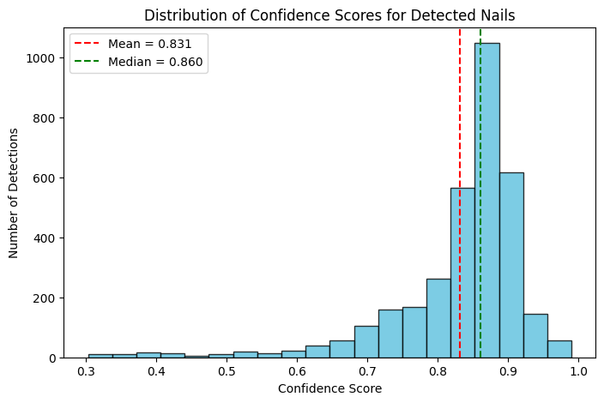
Confidence Score Distribution
Overall mean confidence: 0.8313
Median confidence: 0.8605
Std deviation: 0.0979
Old Values:
Overall mean confidence: 0.7809
Median confidence: 0.8196
Std deviation: 0.1311

Slide 4
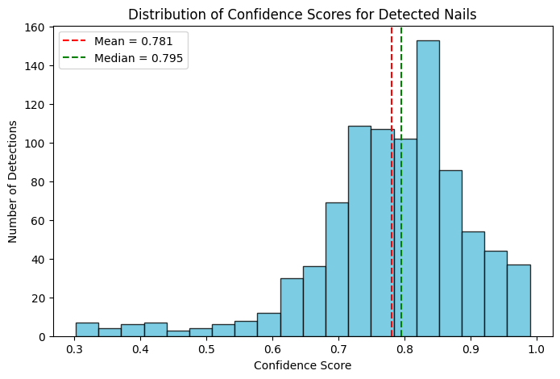
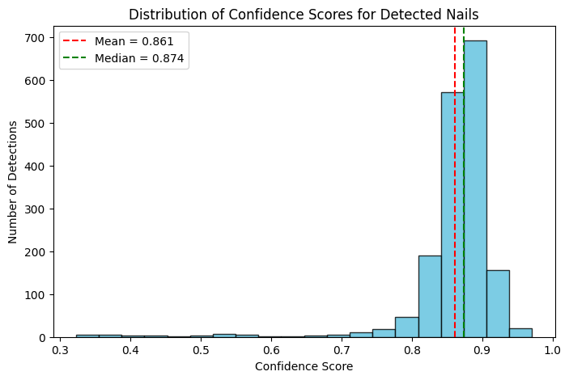
healthy other
Overall mean confidence: 0.7807
Median confidence: 0.7954
Std deviation: 0.1174
Overall mean confidence: 0.8612
Median confidence: 0.8737
Std deviation: 0.0713

Slide 5
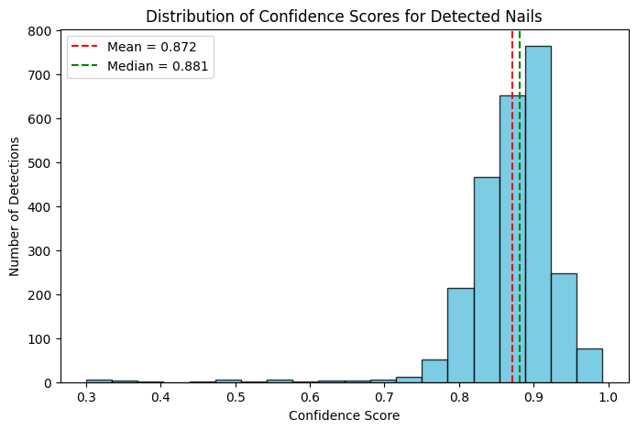
nail melanoma non melanoma
Overall mean confidence: 0.8721
Median confidence: 0.8814
Std deviation: 0.0628
Overall mean confidence: 0.7807
Median confidence: 0.7954
Std deviation: 0.1174

Slide 6
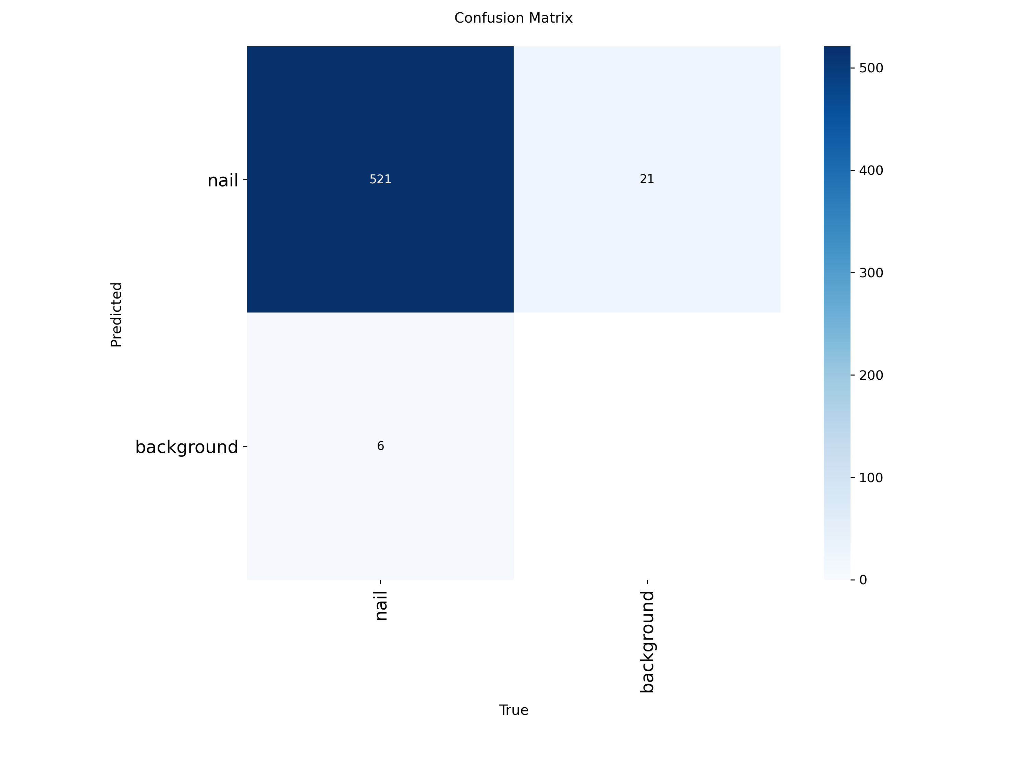
Experiment 3: epoch 50, batch 8

Slide 7
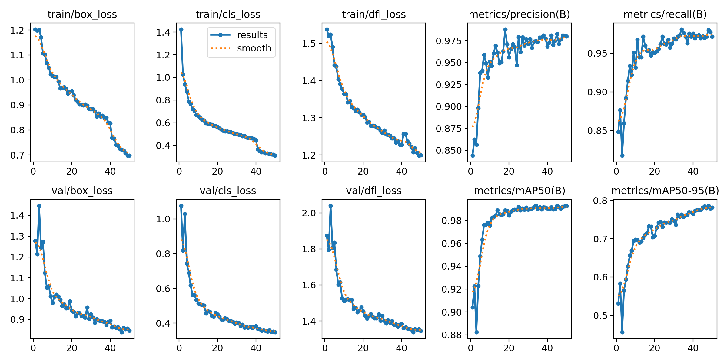

Slide 8
Dataset with Numbers
Each class has the following number of images:
onycholysis: 110
onychomycosis: 574
psoriasis: 684
beau_s lines: 102
koilonychia: 38
leukonychia: 31
healthy: 491
NailMelanoma: 473
Bounding Box Algorithm could detect 3255 Nails
False Positives: 29
False Negatives: 13
True Positives: 3226
Nail Melanoma: 473 (18%)
Healthy: 491 (19%) Non Melanoma:
Other: 1539 (61%) (H+O) 2030 82%
Precision = $\frac{TP}{TP+FP} = 0,9911$​
F1-Score= 2 $×\frac{Precision × Recall}{Precision + Recall} =0,9935$
Recall = $\frac{TP}{TP+FN} = 0,996$

Slide 9
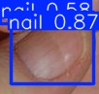
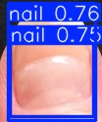
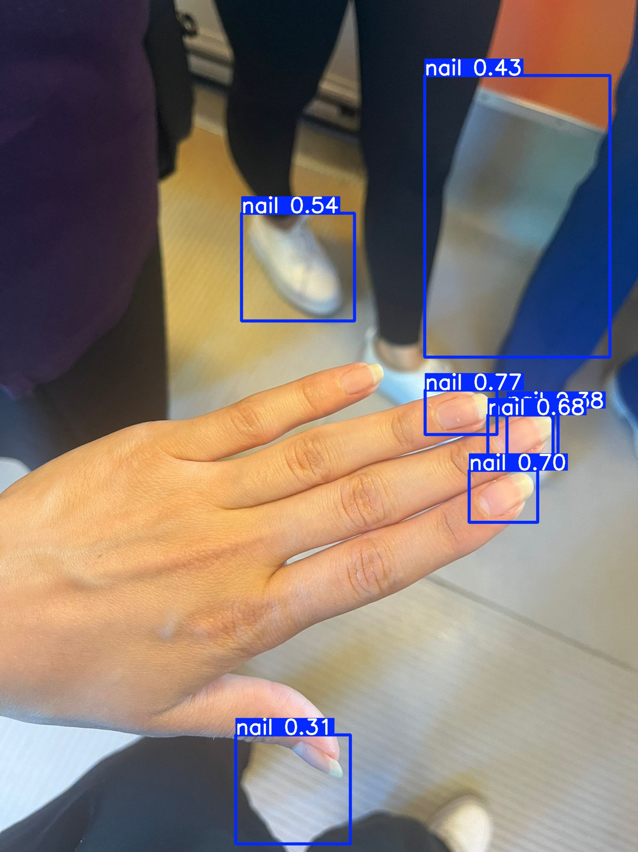
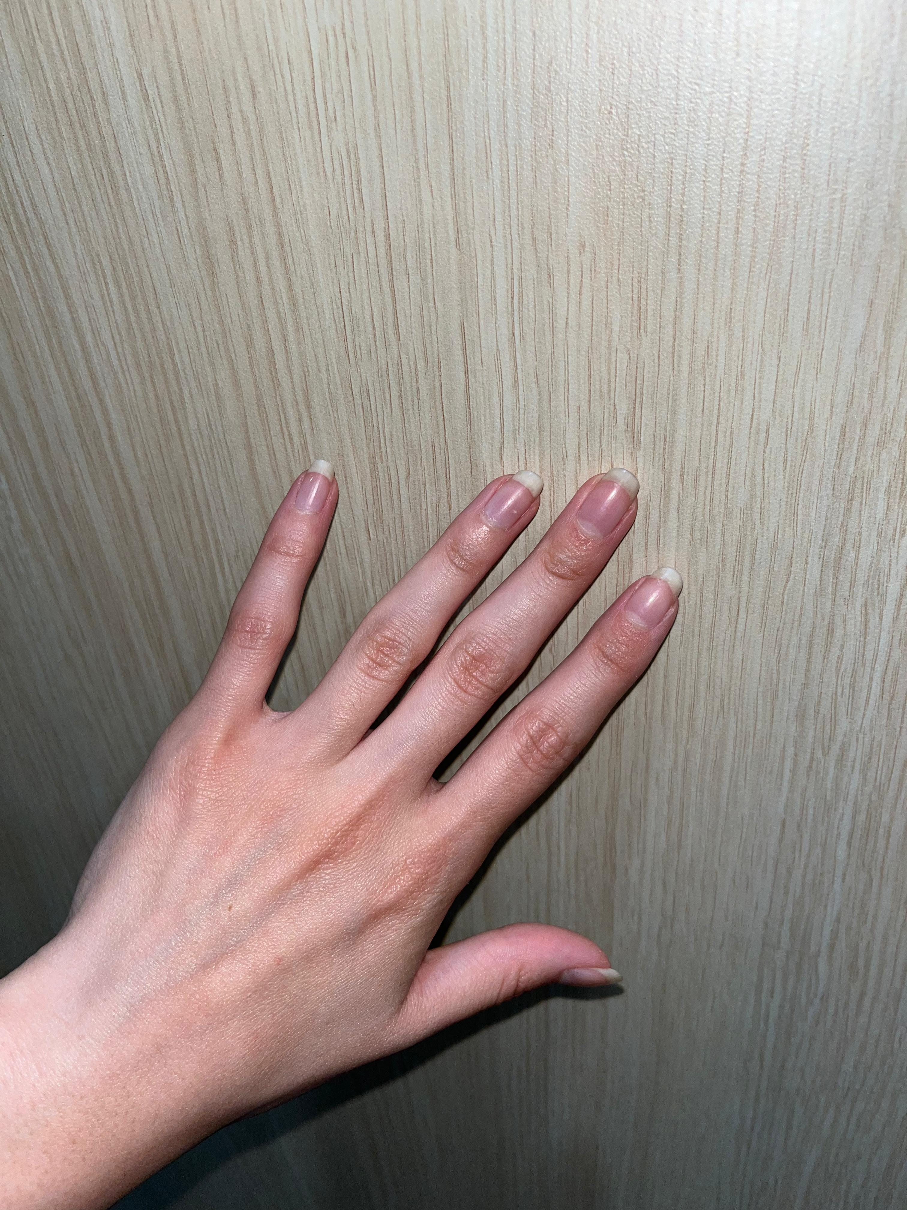
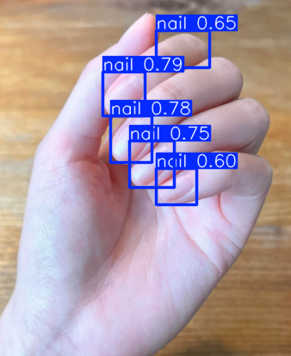
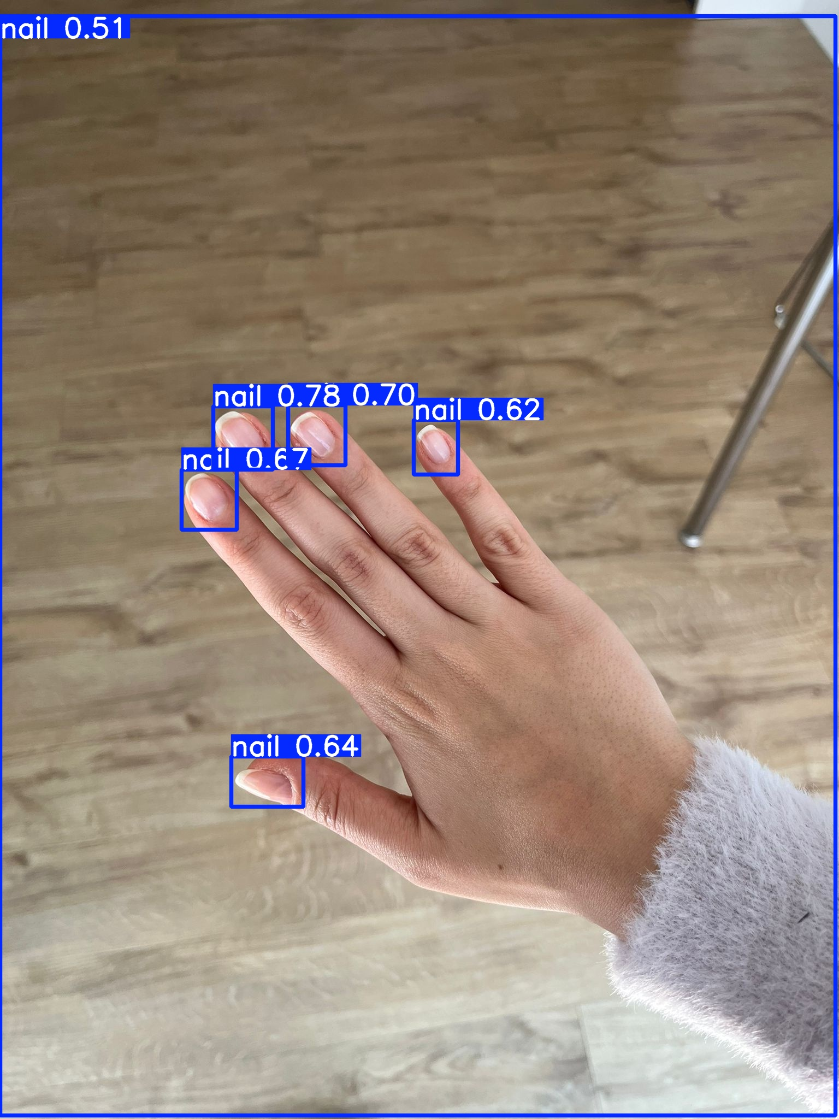
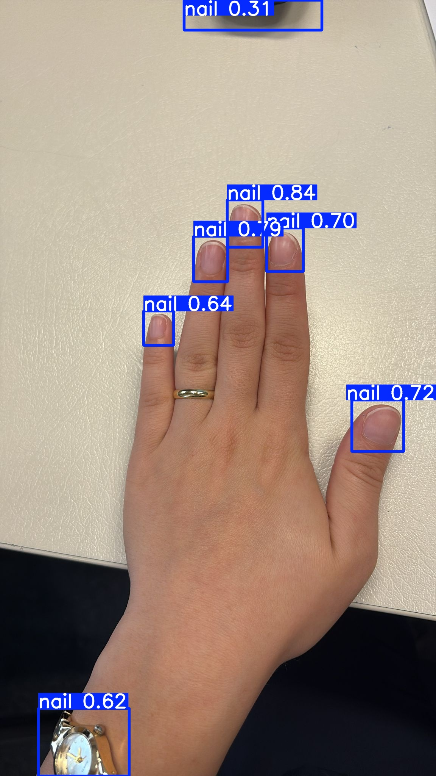
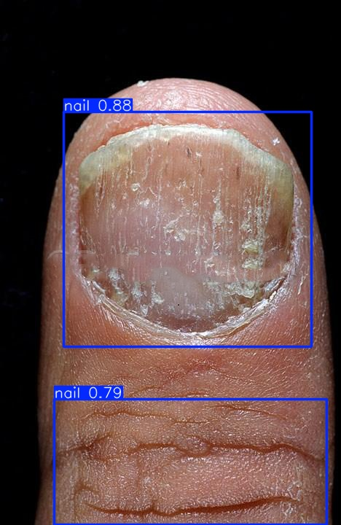
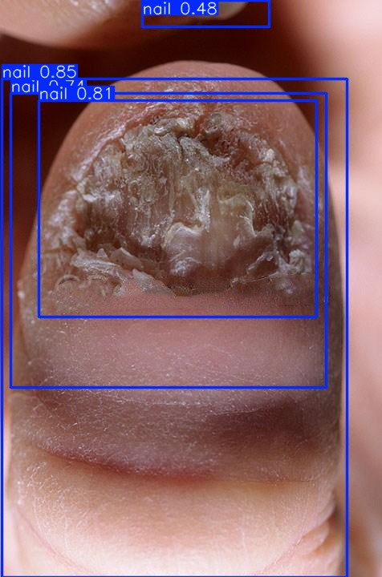
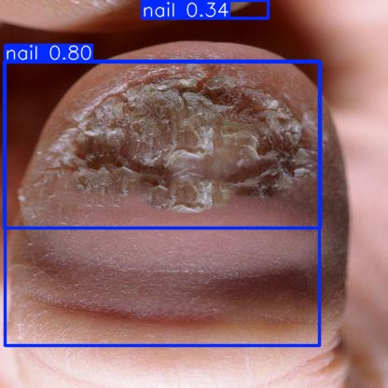
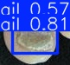
Some of the errors

Slide 10
Models to Fine-Tune
Vision Transformer ViT-B/16 (has self attention to capture dependencies and relationships within input sequences, learns the global context, good for explainability)
YOLO (new versions have XAI but mostly focused on object detection)
Hyperparameters to experiment with:
epochs
batch size
learning rate

Slide 11
Vision Transformer Fine-Tuning Results (Multi Class)
 | epochs | batch size | learning rate | accuracy | F1-Score (healthy) | F1-Score (melanoma) | F1-Score (other)
1 (initial values) | 10 | 32 | 1e-3 | 0,97 | 0,98 | 0,95 | 0,97
2 | 20 | 32 | 1e-3 | 0,98 | 0,98 | 0,97 | 0,98
3 | 50 | 32 | 1e-3 | 0,98 | 0,98 | 0,97 | 0,98
4 | 10 | 16 | 1e-3 | 0,98 | 0,98 | 0,97 | 0,98
5 | 20 | 16 | 1e-3 | 0,98 | 0,98 | 0,96 | 0,98
6 | 50 | 16 | 1e-3 | 0,98 | 0,98 | 0,97 | 0,98
7 | 10 | 16 | 3e-4 | 0,98 | 0,98 | 0,97 | 0,98
8 | 20 | 16 | 3e-4 | 0,97 | 0,98 | 0,95 | 0,97
9 | 50 | 16 | 3e-4 | 0,98 | 0,98 | 0,97 | 0,98

Slide 12
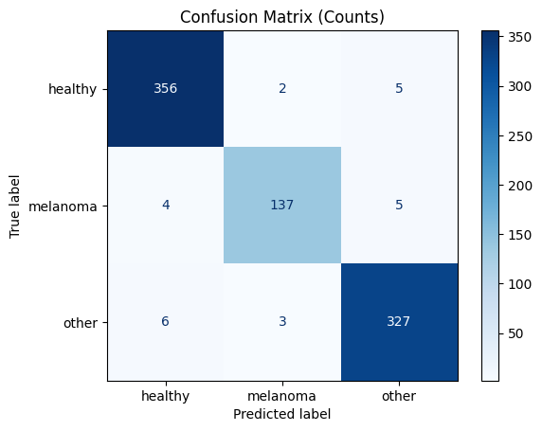
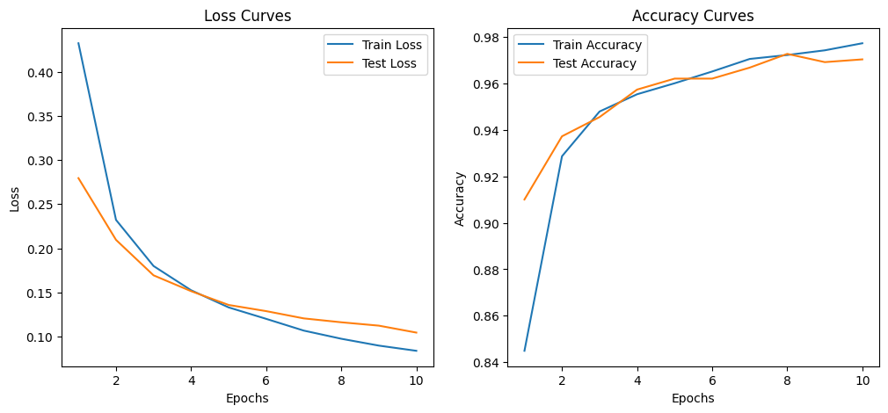
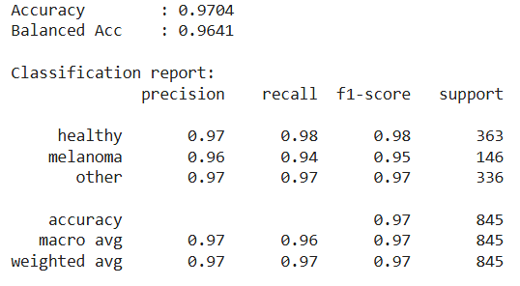
Vision Transformer: epochs: 10 batch size: 32 lr: 1e-3

Slide 13

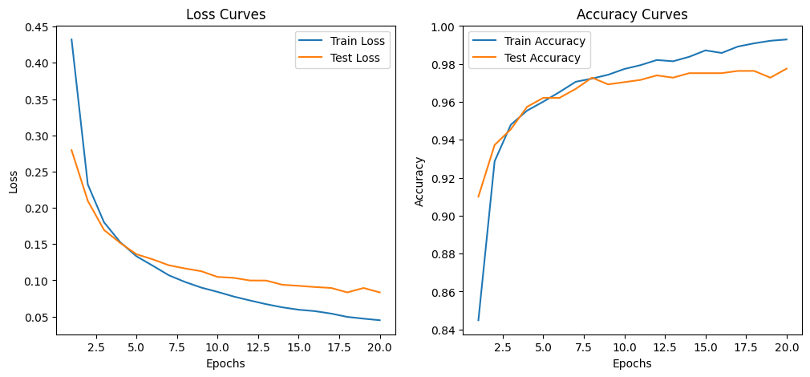
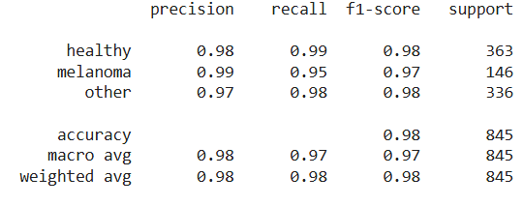
epochs:20, batch size: 32, lr: 1e-3

Slide 14

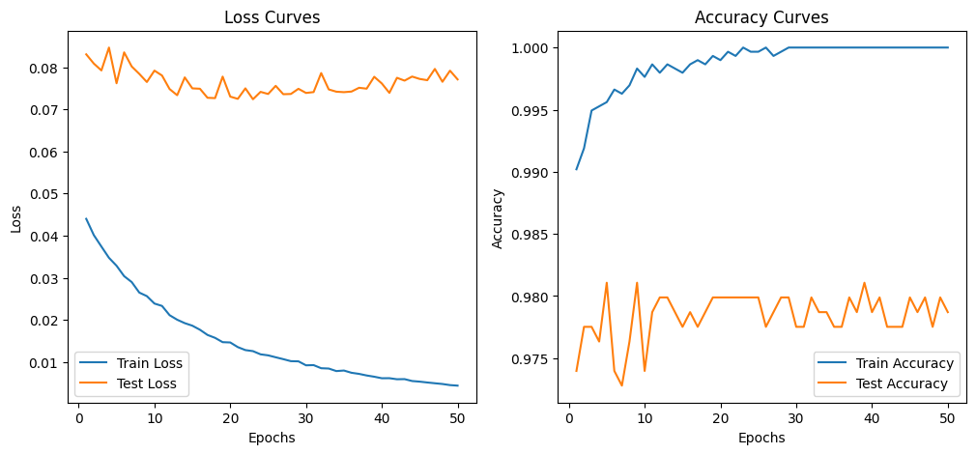
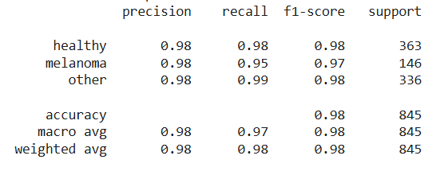
epochs: 50, batch size: 32, lr: 1e-3

Slide 15
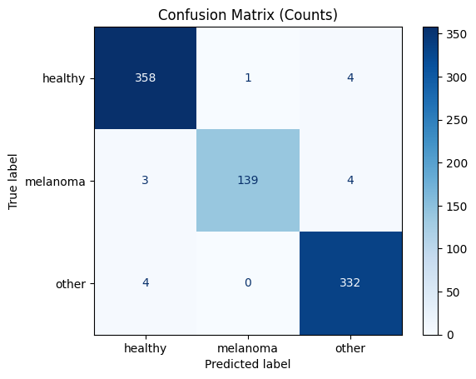
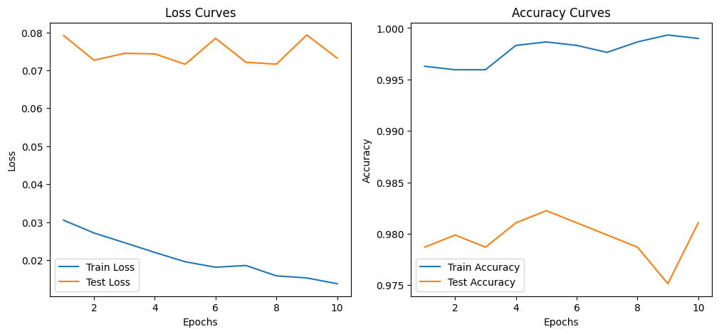
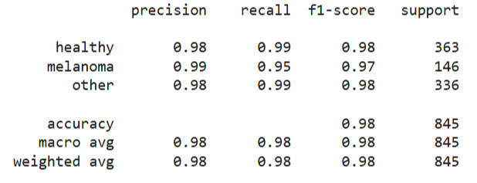
epochs: 10, batch size:16, lr: 1e-3

Slide 16

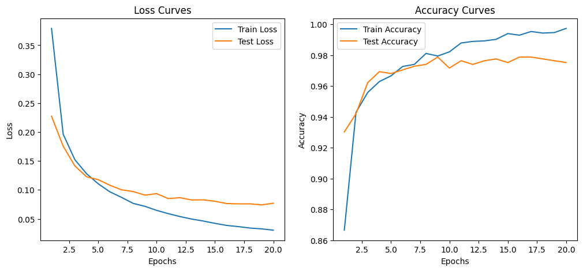
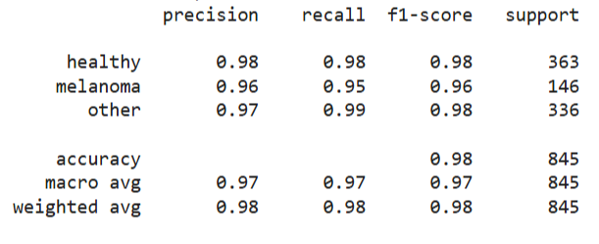
epochs: 20, batch size: 16, lr: 1e-3

Slide 17

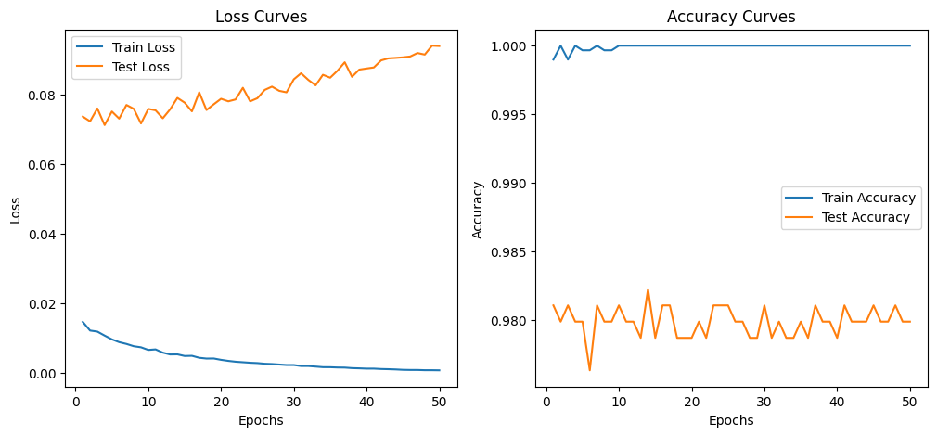
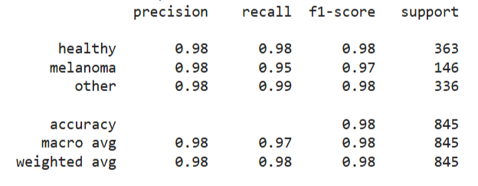
epochs: 50, batch size:16, lr: 1e-3

Slide 18
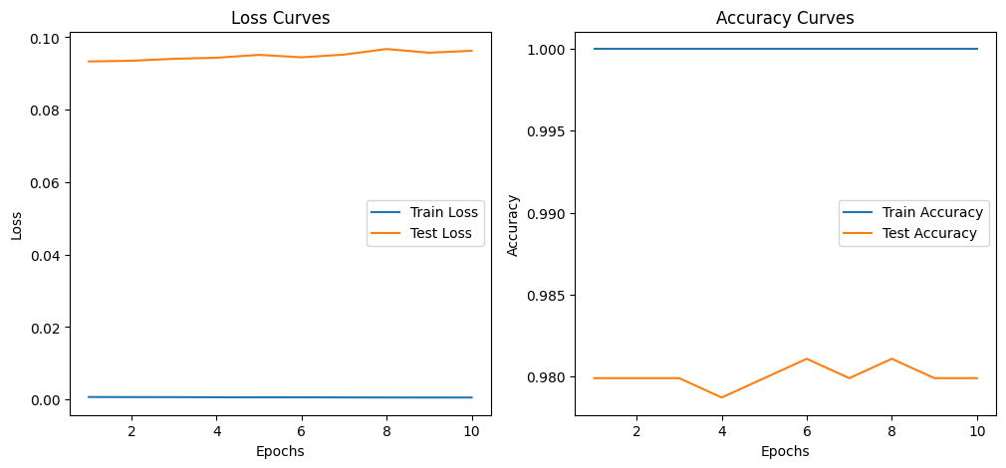
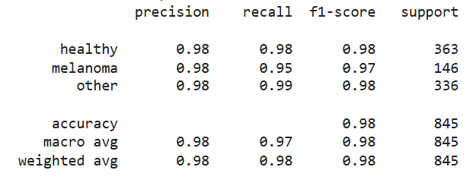
epochs: 10, batch size: 16, lr:3e-4

Slide 19

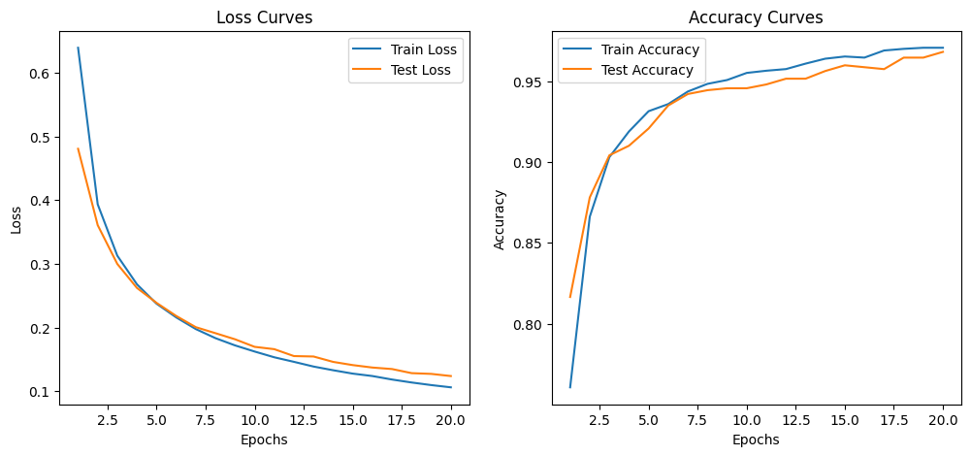
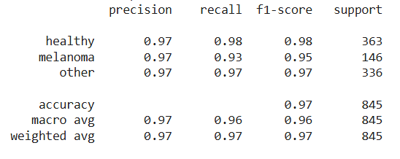
epochs: 20, batch size:16, lr:3e-4

Slide 20

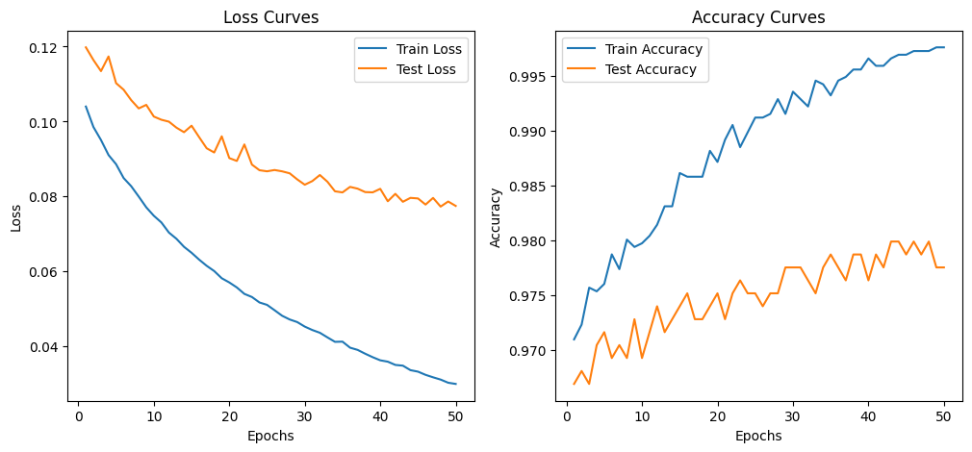
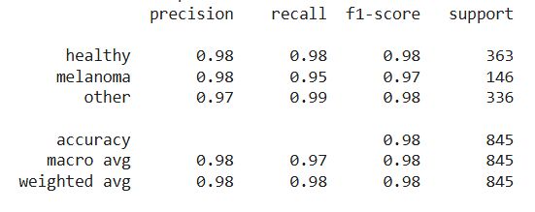
epochs: 50, batch size:16, lr:3e-4

Slide 21
YOLO Fine Tuning Results (Multi Class)
 | epochs | batch size | learning rate | accuracy | F1-Score (healthy) | F1-Score (melanoma) | F1-Score (other)
1 (initial values) | 20 | 32 | 1e-3 | 0,982 | 0,98 | 0,96 | 0,98
2 | 10 | 32 | 1e-3 | 0,986 | 0,99 | 0,96 | 0,98
3 | 50 | 32 | 1e-3 | 0,985 | 0,98 | 0,97 | 0,98
4 | 10 | 16 | 1e-3 | 0,976 | 0,98 | 0,94 | 0,97
5 | 20 | 16 | 1e-3 | 0,985 | 0,99 | 0,96 | 0,98
6 | 50 | 16 | 1e-3 | 0,978 | 0,98 | 0,96 | 0,97
7 | 10 | 16 | 3e-4 | 0,986 | 0,99 | 0,96 | 0,98
8 | 20 | 16 | 3e-4 | 0,982 | 0,98 | 0,96 | 0,98
9 | 50 | 16 | 3e-4 | 0,985 | 0,98 | 0,97 | 0,98

Slide 22
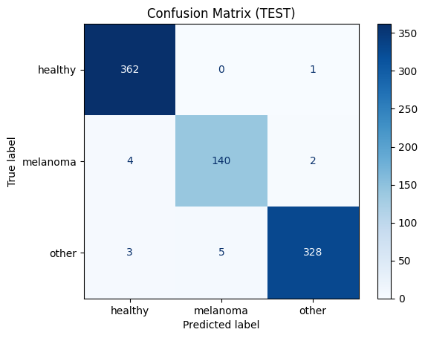
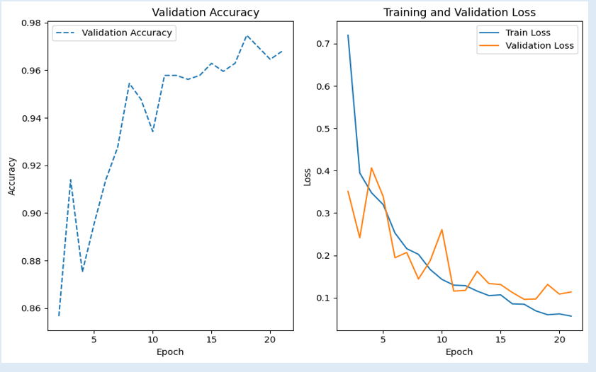
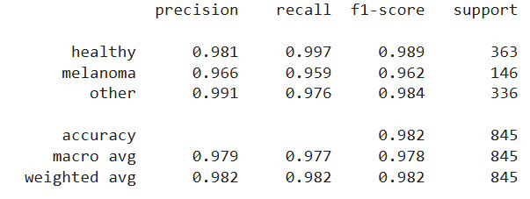
YOLO: epochs:20, batch size:32, lr: 1e-3

Slide 23

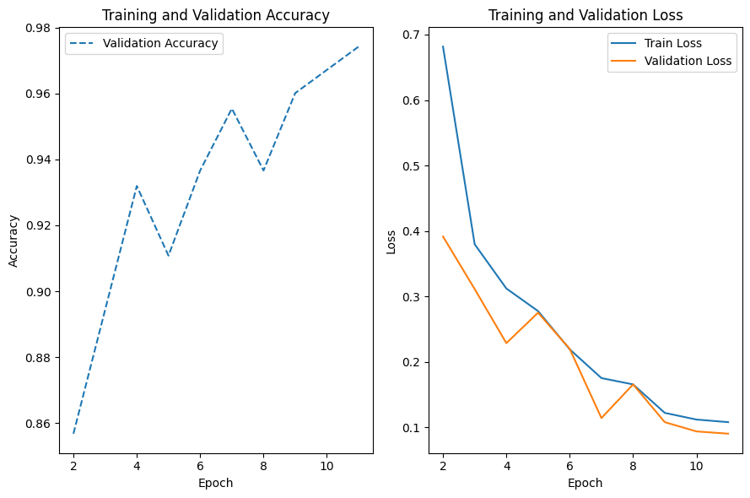
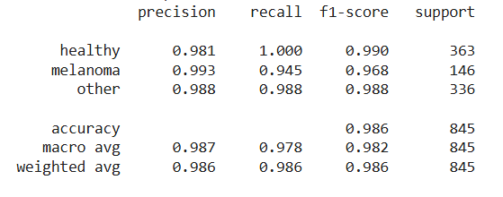
epochs: 10, batch size: 32, lr: 1e-3

Slide 24

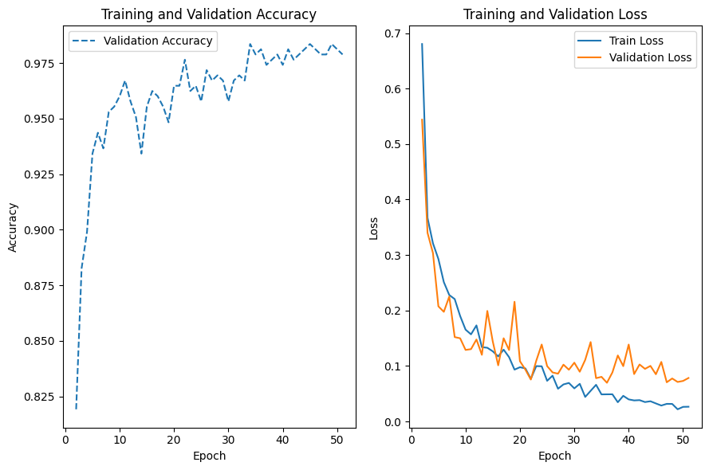
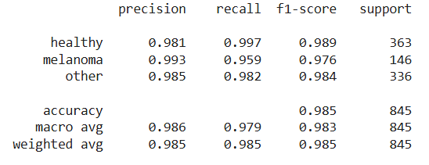
epochs:50, batch size:32, lr:1e-3

Slide 25

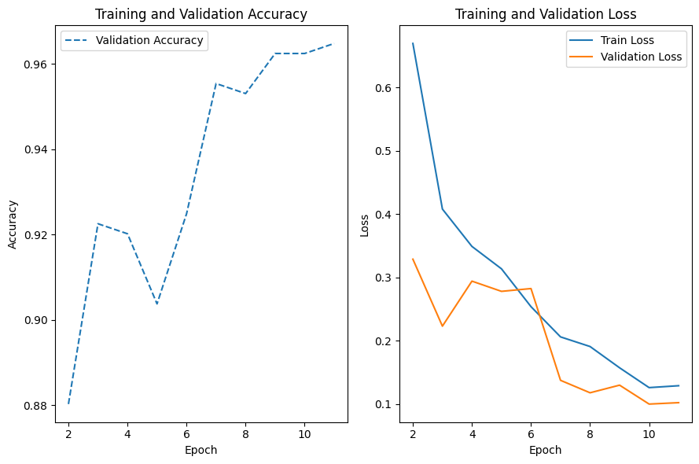
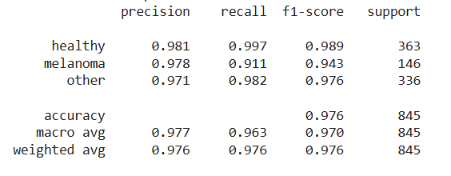
epochs: 10, batch size:16 lr: 1e-3

Slide 26

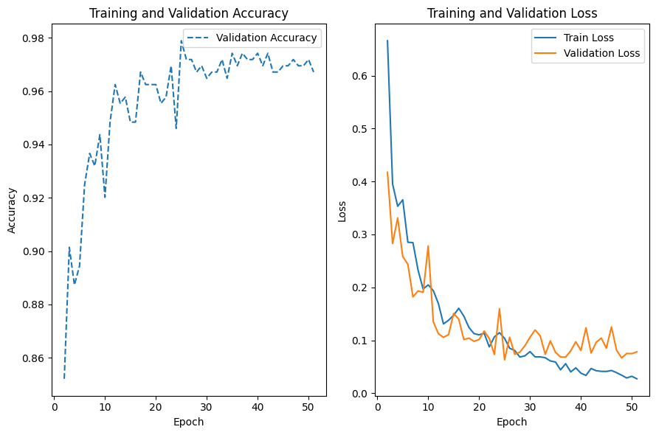
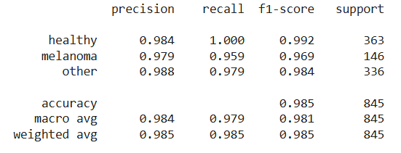
epochs:20, batch size:16, lr: 1e-3

Slide 27

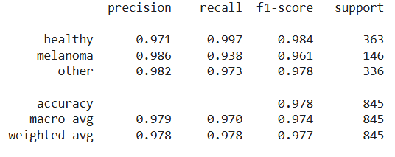
epochs: 50, batch size:16, lr: 1e-3

Slide 28
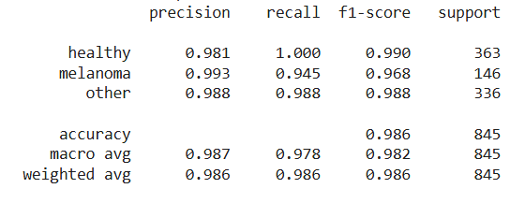
epochs:10, batch size:32, lr: 3e-4

Slide 29


epochs: 20, batch size: 32, lr: 3e-4

Slide 30

epochs: 50, batch size: 32, lr:3e-4

Slide 31


ViT vs YOLO
highly stable results, with overall accuracy consistently around 0.98.
strong generalization and minimal sensitivity to hyperparameter changes
Although YOLO is primarily an object detection architecture, it also achieved strong classification results when fine-tuned in a multi-class setting.
Both models reach excellent performance overall, with extremely high classification accuracy across all three classes.
Moreover, Vision Transformer can be advantageous for the explainability, since it has Self Attention Mechanism→ more compatible with XAI methods

Slide 32
Vision Transformer | YOLO
A pure image classification model | Primarily an object detection model
uses transformer-based self-attention to understand the full image as a whole → more explainable | can be used for classification, but its optimized for detection.
Captures global context → good for subtle disease patterns | very fast inference, easy to fine-tune
Scales well with larger datasets. | works well even with medium-sized datasets.
Strong classification accuracy. | Strong performance on small features (e.g., dark bands in nails).
---Needs more data or aggressive augmentation. | ---Global understanding and explainibility of image is weaker
---Training slower & computationally more expensive. | ---Classification head is not as strong as ViT
---Harder to optimize without proper hyperparameters

Slide 33


















XAI: heatmaps from Vision Transformer

